Slide 1

MOTHER TONGUE
CHAPTER 10
Notes:
Hello everyone, the chapter I will be presenting is chapter 10: Order out of Chaos.
To make it more specific, I have divided the chapter into parts, which I will go over in order.

Slide 2

1. Vocabulary
Chapter 10
Notes:
Onto the first part: (read title)

Slide 3

vocabulary
Shakespeare
Around 20 000
Stopped trying
Difference in numbers
Fun fact
  Shakespeare has never written:
  Bible, Trinity or Holy Ghost
Notes:
Experts tried to count how many words people knew
e.g.: Shakespeare
Academics estimated that Shakespeare had a vocabulary of around 20,000 words (which is extremely low)
People stopped trying to count eventually because one can possess thousands of words without ever using them!
The numbers were too different
Fun fact: Shakespeare has never written the words: Bible, Trinity, or Holy Ghost. That doesn’t necessarily mean that he didn’t know them.

Slide 4

vocabulary
PERSON | WORDS
Av. Farm labourer | 300
Well-read person | 20 000
Max Müller
Stuart Berg Flexner
Hard to calculate
Notes:
Philologist Max Müller thought the average farm labourer had an everyday vocab of only 300 words!
Stuart Berg Flexner suggested the average well-read person knew about 20,000 words and used about 1,500 to 2,000 in a normal week’s conversation
It basically comes down to vocabulary being hard to calculate

Slide 5
2. Problems in dictionaries
Chapter 10

Slide 6
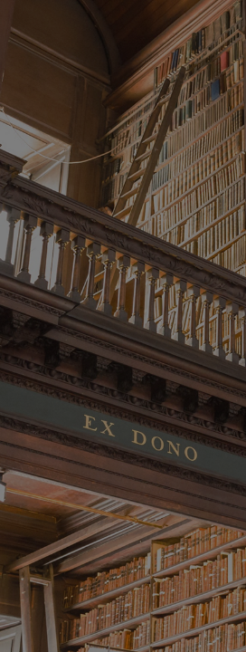
Problems in dictionaries
Meaning ➔ written down
“The simple fact is that it is hard to remember what we remember, so to speak.” (Bryson, P141)
Shakespeare example
Notes:
Back then it was hard to remember every meaning of a word because it wasn’t written down, and they couldn’t remember every definition.
“The simple fact is that it is hard to remember what we remember, so to speak.”
= The number of words we use is much smaller than the words we know
(Shakespeare was an example of this, there was no way to discover how many words Shakespeare knew.)

Slide 7
3. The nuances of English
Chapter 10

Slide 8

The nuances of english
and, be, have, it, of, the, to, will, you
Tall & high = same?
Notes:
Fact: the 9 words that account for one-quarter of all the words in English: and, be, have, it, of, the, to, will, you
In a dictionary will be written that tall and high sort of mean the same thing, but you can’t use both words in the same context.
You can say ‘a tall building’, but not a high building’

Slide 9
“on the strength of dictionary definitions alone a foreign visitor to your home could be excused for telling you that you have an abnormal child, that your wife’s cooking is exceedingly odorous, and that your speech at a recent sales conference was laughable, and intend nothing but the warmest praise.”
‘‘
”
- bryson, p143
Notes:
So some synonymous words cannot be used as each other’s replacement, which Bryson proves with an example: (read quote)
I have underlined the words that replaced their synonyms, and as you can see it doesn’t fit, and sounds like an insult.

Slide 10
4. The invention of new words
Chapter 10

Slide 11
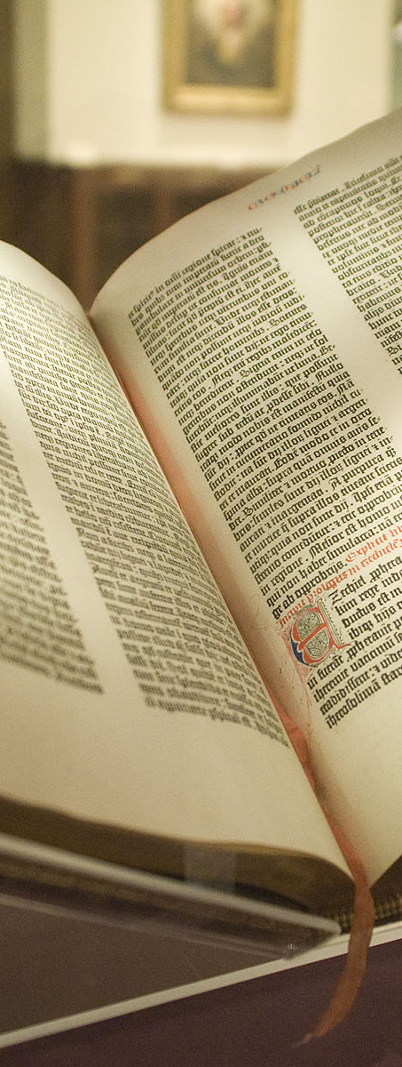
The invention of new words
“No dictionary of a living tongue can ever be perfect, since while it is hastening to publication, some words are budding, and some are fading away.” (Samuel Johnson)
Notes:
English and other languages are changing all the time.
S. Johnson once said: (read quote)
In other words: when a new dictionary is published, some words are getting too old and disappear from the language, and other words are new and being used more often.

Slide 12
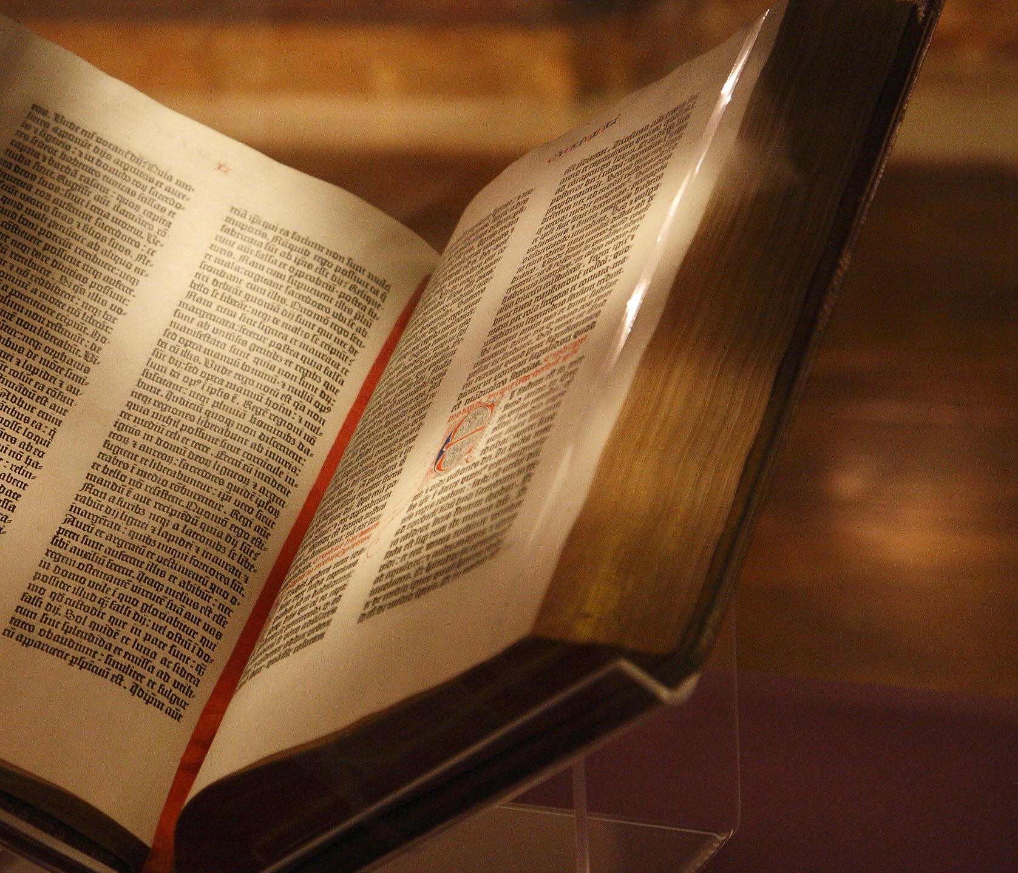
New York Times
15,000-20,000/y
Notes:
A report in the New York Times in 1990 said words were being added at the rate of 15,000 to 20,000 a year.

Slide 13
6. Johnson’s dictionary
(1709-1784)
Chapter 10
Notes:
there were dictionaries before Johnson’s, but his was the one we remember most, along with Webster’s dictionary and the latest Oxford dictionary. All of them had flaws and shortcomings but were still described as magnificent, which is why they are the ones talked about in the chapter.

Slide 14
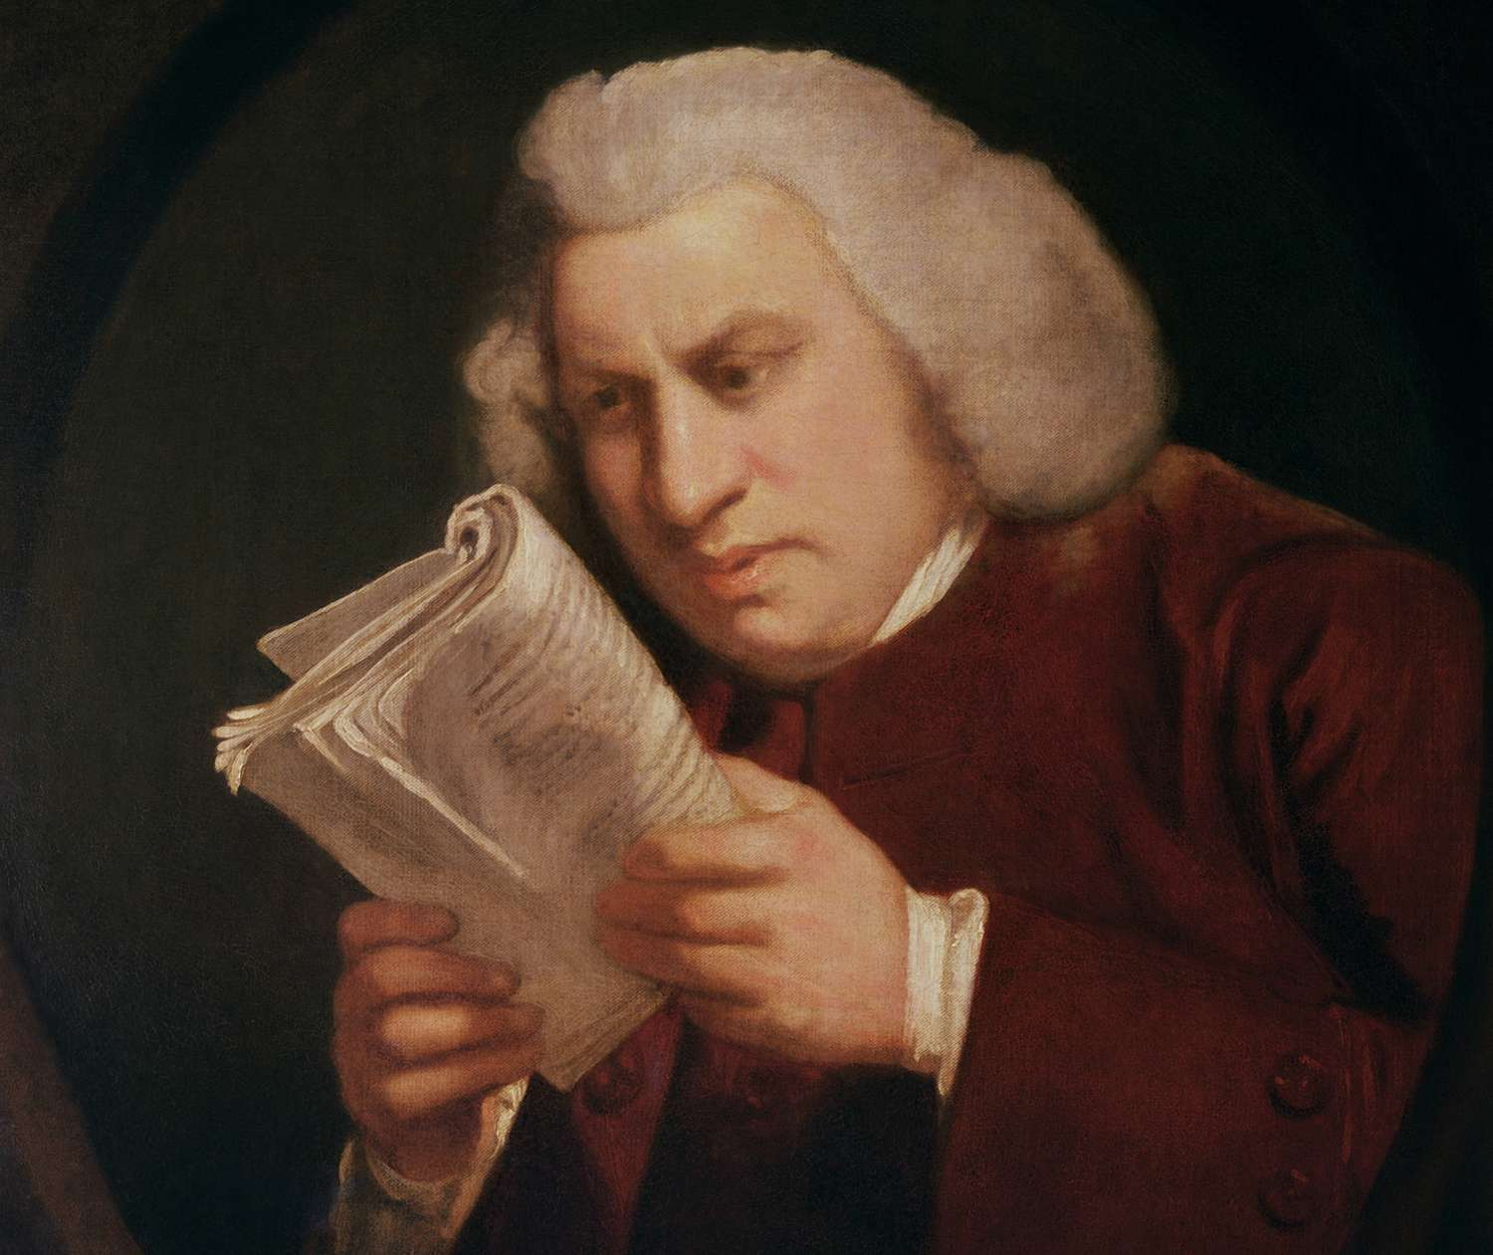
Johnson’s dictionary
Given contract: Robert Dodsley
Mistakes:
          fancy, but phantom
Institutionalized:
                flower & flour
                metal & mettle
Notes:
Given a contract by London Publisher Robert Dodsley to make an English dictionary
Even though his dictionary was great, he still made mistakes, some of which we now write as correct English
example of his mistakes:
Fancy with an f, but phantom with a ph
Institutionalised differences such as:
Flower and flour
Metal and mettle

Slide 15
Johnson’s dictionary
Dictionary: 9 years
Incorrect etymologies
Extremely long definitions
Notes:
Sometimes his etymologies were incorrect, and his proofreading careless
He would write definitions that were not simply written and were sometimes extremely long, even taking up multiple pages.

Slide 16
Johnson’s dictionary
A Dictionary of the English Language: In Which the Words are Deduced from their Originals, and Illustrated in their Different Significations by Examples from the Best Writers. To Which are Prefixed A History of the Language, and an English Grammar.
Notes:
This was the original name of Johnson’s dictionary, and as you can see it’s far too long, so it was shortened.

Slide 17
7. Webster’s dictionary
(1758-1843)
Chapter 10
Notes:
Johnson was soon to be exceeded by one man: Noah Webster.

Slide 18
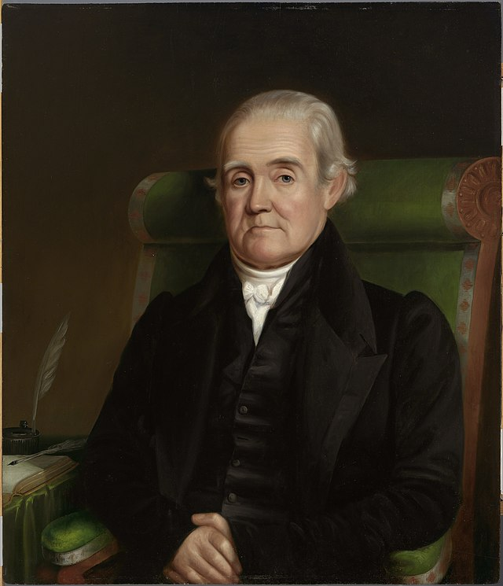
webster’s dictionary
Mastered 23 languages
Elementary Spelling Book
60 million copies
(Except for Bible) best selling book
Notes:
Claimed to have mastered 23 languages, but that was proven to be false.
His book The Elementary Spelling Book (1788) sold so many copies that historians lost track
It was estimated that by the end of the 19th century, it had sold more than 60 million copies
= Except for Bible, it is probably the best-selling book in American history

Slide 19
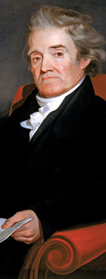
webster’s dictionary
Religious Christian
6,000 Bible references
Radical changes:
      wimmen (women)
      tuf (tough)
Notes:
An important thing to note is that Noah Webster was a highly religious Christian. He said: “Education is useless without the Bible”. His dictionary has 6 thousand Bible references and is therefore a pretty helpful tool for people who are studying the Bible.
What was also odd about Webster is that he wanted to make some radical changes to the English language, like:

Slide 20
webster’s dictionary
American tendency to drop u
Irregular spellings:
              Acre, glamour
70,000 words
Merriam-Webster Dictionary
Notes:
He also attacked the American tendency to drop the ‘u’ from words like colour, humour, because it would make some words confusing.
His dictionary retained many irregular spellings, some of which we still use today:
Acre, glamour (acre, not written as a-c-e-r, and glamour, which by American standards would be spelled as g-l-a-m-o-r)
His dictionary contained 70,000 words, far more than Johnson’s
The volume after his death was called the Merriam-Webster dictionary, a better version

Slide 21
8. Oxford English Dictionary
Chapter 10
Notes:
Most ambitious philological exercise ever undertaken
The intention was to record every word used in English since 1150 and trace it back through all its shifting meanings, spelling and uses.

Slide 22
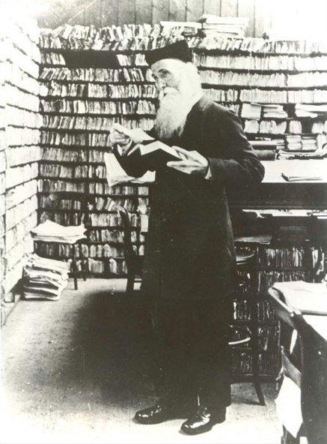
Oxford english dictionary
James August Henry Murray (1837-1915)
11 children
4 decades, 15,000 pages
volunteers
Notes:
The man chosen for the job: James August Henry Murray(1837-1915)
His eleven children were roped into the business from the moment they learned the alphabet
Project took more than 4 decades, the book had 15,000 pages
Hundreds of volunteers helped him with the work

Slide 23
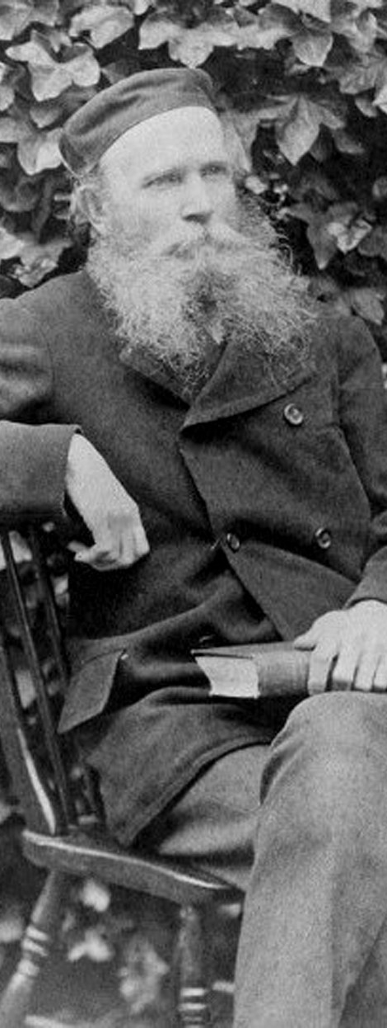
Oxford English dictionary
Dr. W.C. Minor
Broadmoor
1y: 12,000 contributions
Notes:
A notable contributor was Dr W.C. Minor, but he was an inmate at Broadmoor, a hospital for the criminally insane
In one year, he made 12,000 contributions to the dictionary from the private library at Broadmoor

Slide 24
Oxford english dictionary
1884: A New English Dictionary on Historical Principles; Founded Mainly on the Materials Collected by The Philological Society
The Oxford English Dictionary
20 updates
Notes:
In 1884, the dictionary was beginning to be published, under the name of A New English Dictionary on Historical Principles; Founded Mainly on the Materials Collected by The Philological Society.
After Murray died, the dictionary has been known as The Oxford English Dictionary
Since then, it has been updated over 20 times

Slide 25
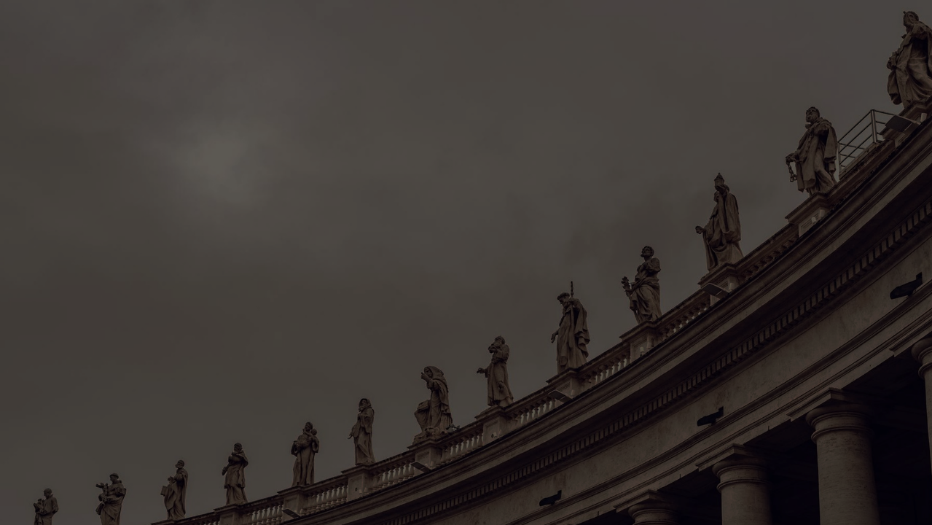
SOURCES
WEBSITES
Websters Dictionary 1828 - Noah Webster. (z.d.). Websters Dictionary 1828. https://webstersdictionary1828.com/NoahWebster
Wikipedia-bijdragers. (2022). A Dictionary of the English Language. Wikipedia. https://nl.wikipedia.org/wiki/A_Dictionary_of_the_English_Language
Wikipedia contributors. (2023). Oxford English Dictionary. Wikipedia. https://en.wikipedia.org/wiki/Oxford_English_Dictionary

